Slide 1
Object-Oriented Programming
WEEK 08|09 Abeeha Sattar

Slide 2
Inheritance so far…
Derived class inherits all the characteristics of the base class
Besides inherited characteristics, derived class may have its own unique characteristics
Major benefit of inheritance is reuse.

Slide 3
Generalization
In OO models, some classes may have common characteristics
We extract these features into a new class and inherit original classes from this new class
This concept is known as Generalization
Generalization and Inheritance are conceptually the same thing
The only difference is that Generalization is used when talking about UML diagrams, and Inheritance is the implementation of the diagrams in code format.

Slide 4
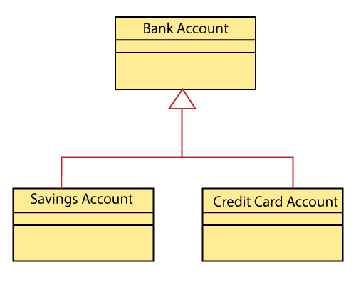
Inheritance v/s Generalization
This would be Generalization
The actual code for these classes would be inheritance!

Slide 5
Polymorphism
Polymorphism is derived from 2 Greek words: poly and morph. The word “poly” means many and “morphs” means forms. So polymorphism means many forms.
The process of representing one form in multiple forms/ways is known as Polymorphism

Slide 6
Think of a real life example of Polymorphism

Slide 7
Types of Polymorphism
Static/Compile-time Polymorphism
Dynamic/Runtime Polymorphism

Slide 8
Static/Compile-time Polymorphism
It is also called Early Binding
It happens where more than one methods share the same name with different parameters or signature and different return type.
It is known as Early Binding because the compiler is aware of the functions with same name and also which overloaded function is to be called is known at compile time.

Slide 9
Function/Method Overloading
Whenever same method name is exiting multiple times in the same class with different number of parameter or different order of parameters or different types of parameters is known as function overloading

Slide 10
Types of Function Overloading
Function Overloading
Constructor Overloading
Operator Overloading (Coming soon!)

Slide 11
Dynamic/Runtime Polymorphism
This refers to the entity which changes its form depending on circumstances at runtime. This concept is akin to a chameleon changing its color at the sight of an approaching object.
Method Overriding uses runtime Polymorphism.
It is also called Late Binding.

Slide 12
Dynamic/Runtime Polymorphism
Runtime Polymorphism is done using virtual and inheritance. (We’ll study this later)
When overriding a method, the behavior of the method is changed for the derived class.

Slide 13
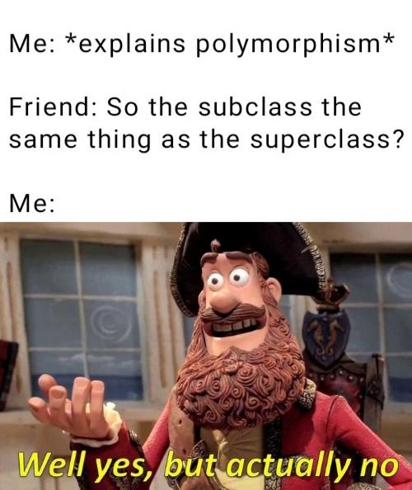
Polymorphism in terms of Inheritance
aka, function overriding
Define any method in both base class and derived class with the same name, same parameters or signature, this concept is known as method overriding

Slide 14
Function Overriding
A class may need to override the default behavior provided by its base class
Reasons for overriding:
Provide behavior specific to a derived class
Extend the default behavior
Restrict the default behavior
Improve performance

Slide 15
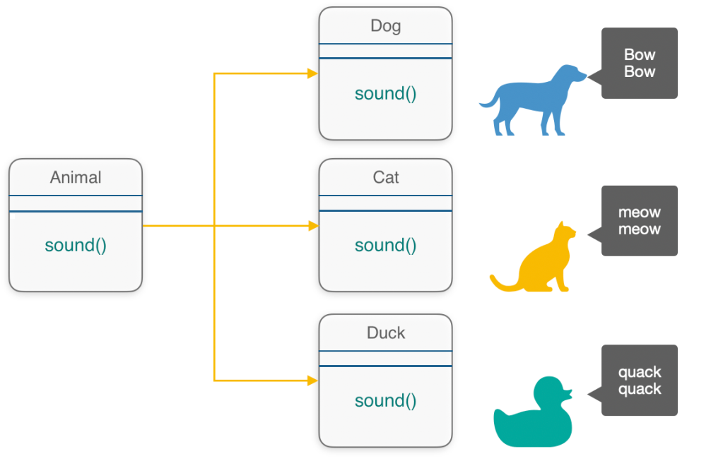
Simple Scenario

Slide 16
Before Overriding
class Animal {
public:
void speak() {
cout << "Talk in some way" << endl;
}
};
class Dog : public Animal {};
class Cat : public Animal {};
class Duck : public Animal {};
Notes:
What would be the output?
int main()
{
Animal literallyAnyAnimal;
Dog spike;
Cat tom;
Duck donald;
literallyAnyAnimal.speak();
spike.speak();
tom.speak();
donald.speak();
}

Slide 17
After Overriding
class Animal {
public:
void speak() {
cout << "Talk in some way" << endl;
}
};
class Dog : public Animal {
public:
void speak() {
cout << "Bow bow" << endl;
}
};
class Cat : public Animal {
public:
void speak() {
cout << "Meow meow" << endl;
}
};
class Duck : public Animal {
public:
void speak() {
cout << "Quack quack" << endl;
}
};
Notes:
What would be the output?
int main()
{
Animal literallyAnyAnimal;
Dog spike;
Cat tom;
Duck donald;
literallyAnyAnimal.speak();
spike.speak();
tom.speak();
donald.speak();
}

Slide 18
How could you call the parent function if needed?
You can call the parent’s function inside any child class by using the scope resolution operator.
For example:
class Dog : public Animal {
public:
void speak() {
Animal::speak();
cout << "Bow bow" << endl;
}
};
But you can’t do this without scope resolution operator. Why?

Slide 19
How could you call the parent function if needed?
You can call also can the parent’ function through the child class object by using the scope resolution operator.
For Example:
tom.Animal::speak();

Slide 20
Hybrid Inheritance and it’s Problems when Overriding Functions
Increased complexity
Reduced understanding
Duplicate features

Slide 21
Duplicate Features – Problem
When inhering from different classes, you might run into duplicate features
For example, an animal living on land breathes differently than an animal living in water. But an amphibious animal lives on land and in water. How do they breathe?
Land Animal
Water Animal
Amphibious Animal

Slide 22
Duplicate Features - Solution
There are two things that you can do. Both of them require overriding the methods in the base classes.
Inside the overridden method:
Call the desired function from the parent classes
Give your own definition of how that function should be performed

Slide 23
Code the solution yourself
???

Slide 24
Problems with Hybrid Inheritance – The Diamond Problem
If the inheritance structure looks like a diamond – we’re going to run into the diamond problem
Class A
Class B
Class C
Class D

Slide 25
Diamond Problem – Code Format
//super parent class
class A {
public:
void name() {
cout << "This is class A \n";
}
};
//base class I
class B : public A {};
//base class II
class C : public A {};
//derived class
class D : public B, public C {};
int main()
{
D d;
d.name();
return 0;
}

Slide 26
Diamond Problem – Possible Solutions
Some languages (like Java, C#) do not allow you to create the diamond hierarchy.
Others provide ways to ignore characteristics from one side
But in C++ we have the concept of “virtual” inheritance to solve this problem

Slide 27
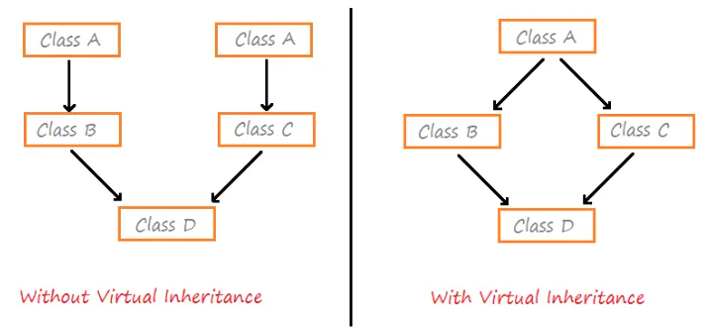
Diamond Problem – Virtual Inheritance
https://pencilprogrammer.com/cpp-tutorials/virtual-inheritance/

Slide 28
Fixing the Diamond Problem
//super parent class
class A {
public:
void name() {
cout << "This is class A \n";
}
};
//base class I
class B : virtual public A {};
//base class II
class C : virtual public A {};
//derived class
class D : public B, public C {};
int main()
{
D d;
d.name();
return 0;
}

Slide 29
Another scenario – with Constructors
class Person {
string name;
public:
Person() {}
Person(string name) {
this->name = name;
}
string getName() {
return name;
}
};
class Teacher : virtual public Person {
public:
Teacher() {}
Teacher(string name) : Person(name) {}
};
class Student : virtual public Person{
public:
Student() {}
Student(string name) : Person(name) {}
};
class TA : public Teacher, public Student {
public:
TA() {}
TA(string name) : Person(name) {}
};
You can’t do this without using virtual inheritance

Slide 30
Fin.
: )

